Slide 1


B.A.R.D. Text and Coordinate Analysis
Coded and Compiled
by Andrew Iraola

Slide 2
BARD Text Analysis Results
Notes:
Lead with text mining

Slide 3
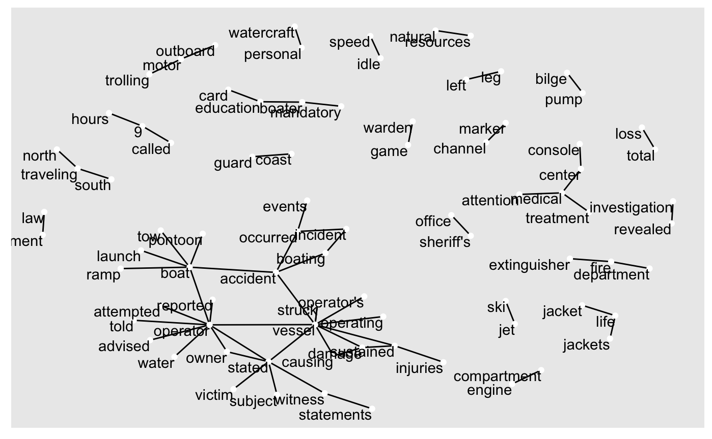

Slide 4
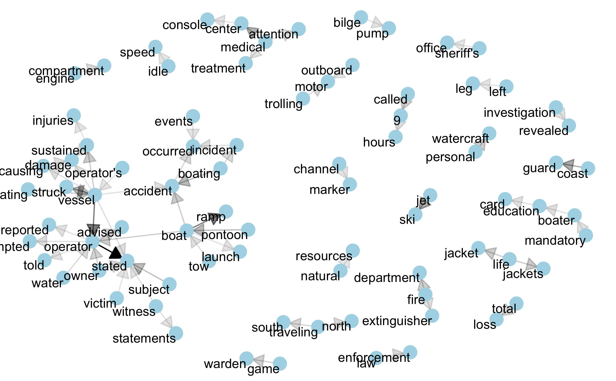

Slide 5
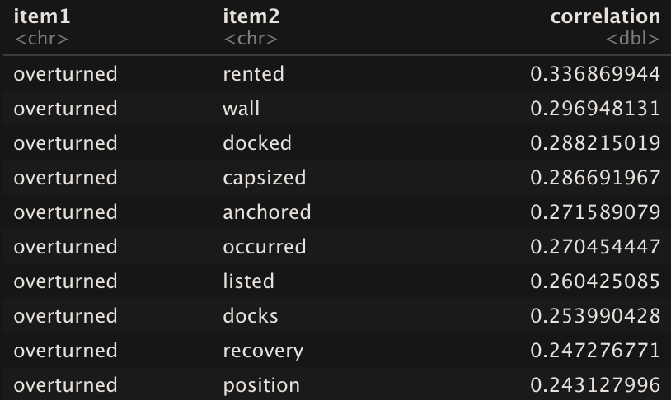
Correlates With the Word, “overturned”
Notes:
Note that we can apply this to any word we want: “kayak”, “canoe”, “pfd”, ”kill switch”

Slide 6
Example #1
“…After speaking to the owner of Jet Funn I determined one of his personal watercraft had been in the accident. The watercraft in question was rented out to someone other than the operator. The owner informed me the watercraft had been returned by another individual who quickly left to go with the girls to the hospital. The watercraft had scrapes and grooves extending from bow to stern on the front port side with purple paint transfer. The fiberglass on the port side foot guard was crushed in an area in wide. Witnesses who were at Lake Front Park said a little after 8:00PM they saw the two girls on a blue jet ski, (vessel #) traveling east, making a turn in front of a purple jet ski, being operated by a middle-aged male traveling south (vessel #1). As vessel #1 crossed in front of vessel #2, vessel #1 hit a wave and struck vessel #2. The impact overturned vessel #1 and both girls were thrown into the water. From this point no one knows what happened to vessel #. Witnesses said the accident happened about meters from the shoreline."

Slide 7
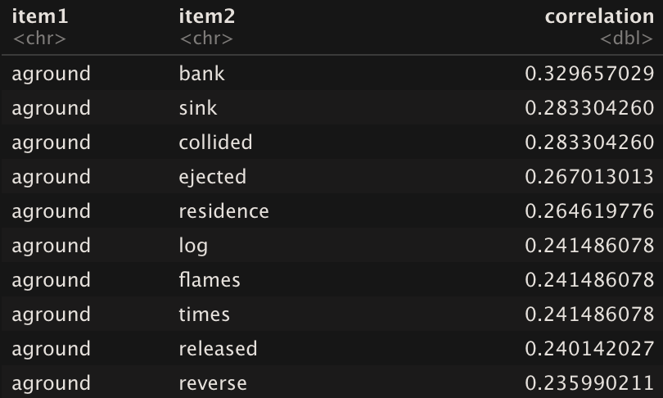
Correlates With the Word, “aground”
Notes:
Also saw the word, ‘unconscious’ at a 30% correlation. Implies that if you have the word ‘aground’ in 100 different reports, it will be in almost 40 of them.

Slide 8
Example #2
“Operator was operating vessel while cruising on plane at night. As operator was operating vessel, passenger was in the bow as the lookout as they were navigating downstream. Operator failed to notice how closely they were to the shoreline and vessel ran aground causing passenger to be ejected overboard. Operator remained on-board vessel and sustained injuries. Passenger sustained serious injuries. Vessel sustained minor damage. Operator was arrested for boating under the influence of alcohol.”

Slide 9
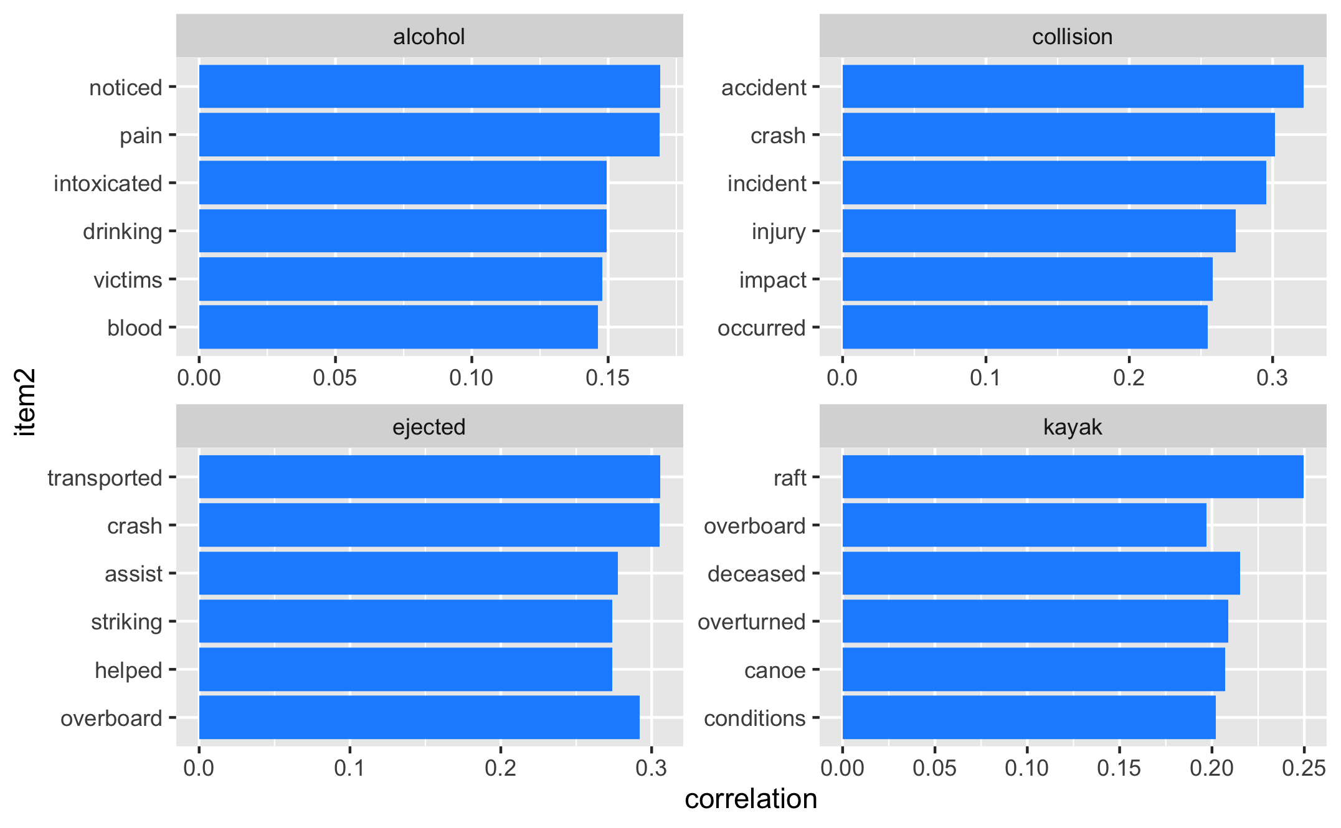

Slide 10
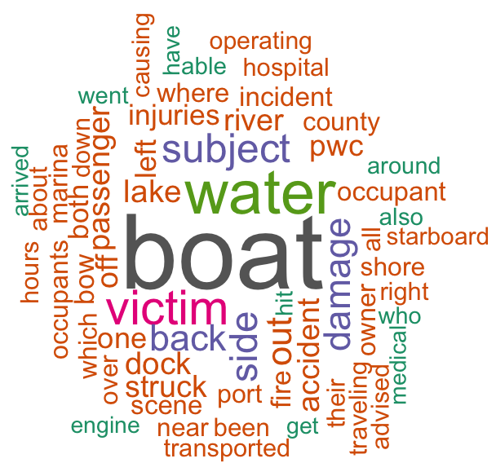
Word Cloud of Most Common Words

Slide 11
BARD Coordinate Mapping Results
Notes:
Lead with text mining

Slide 12
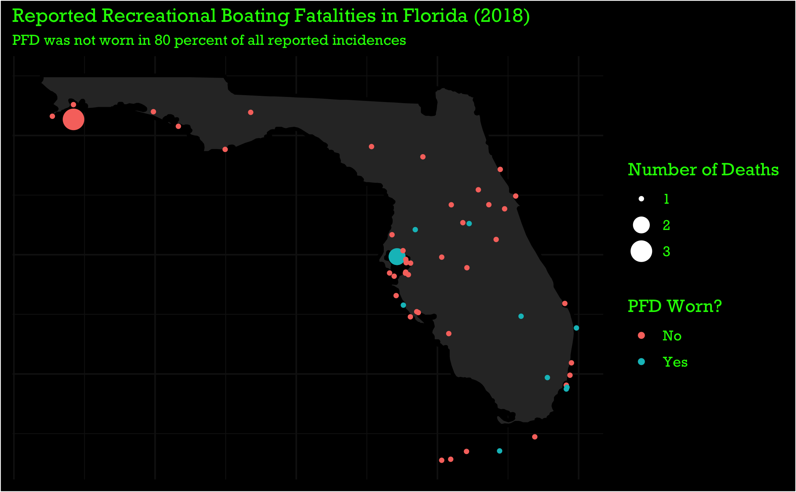

Slide 13
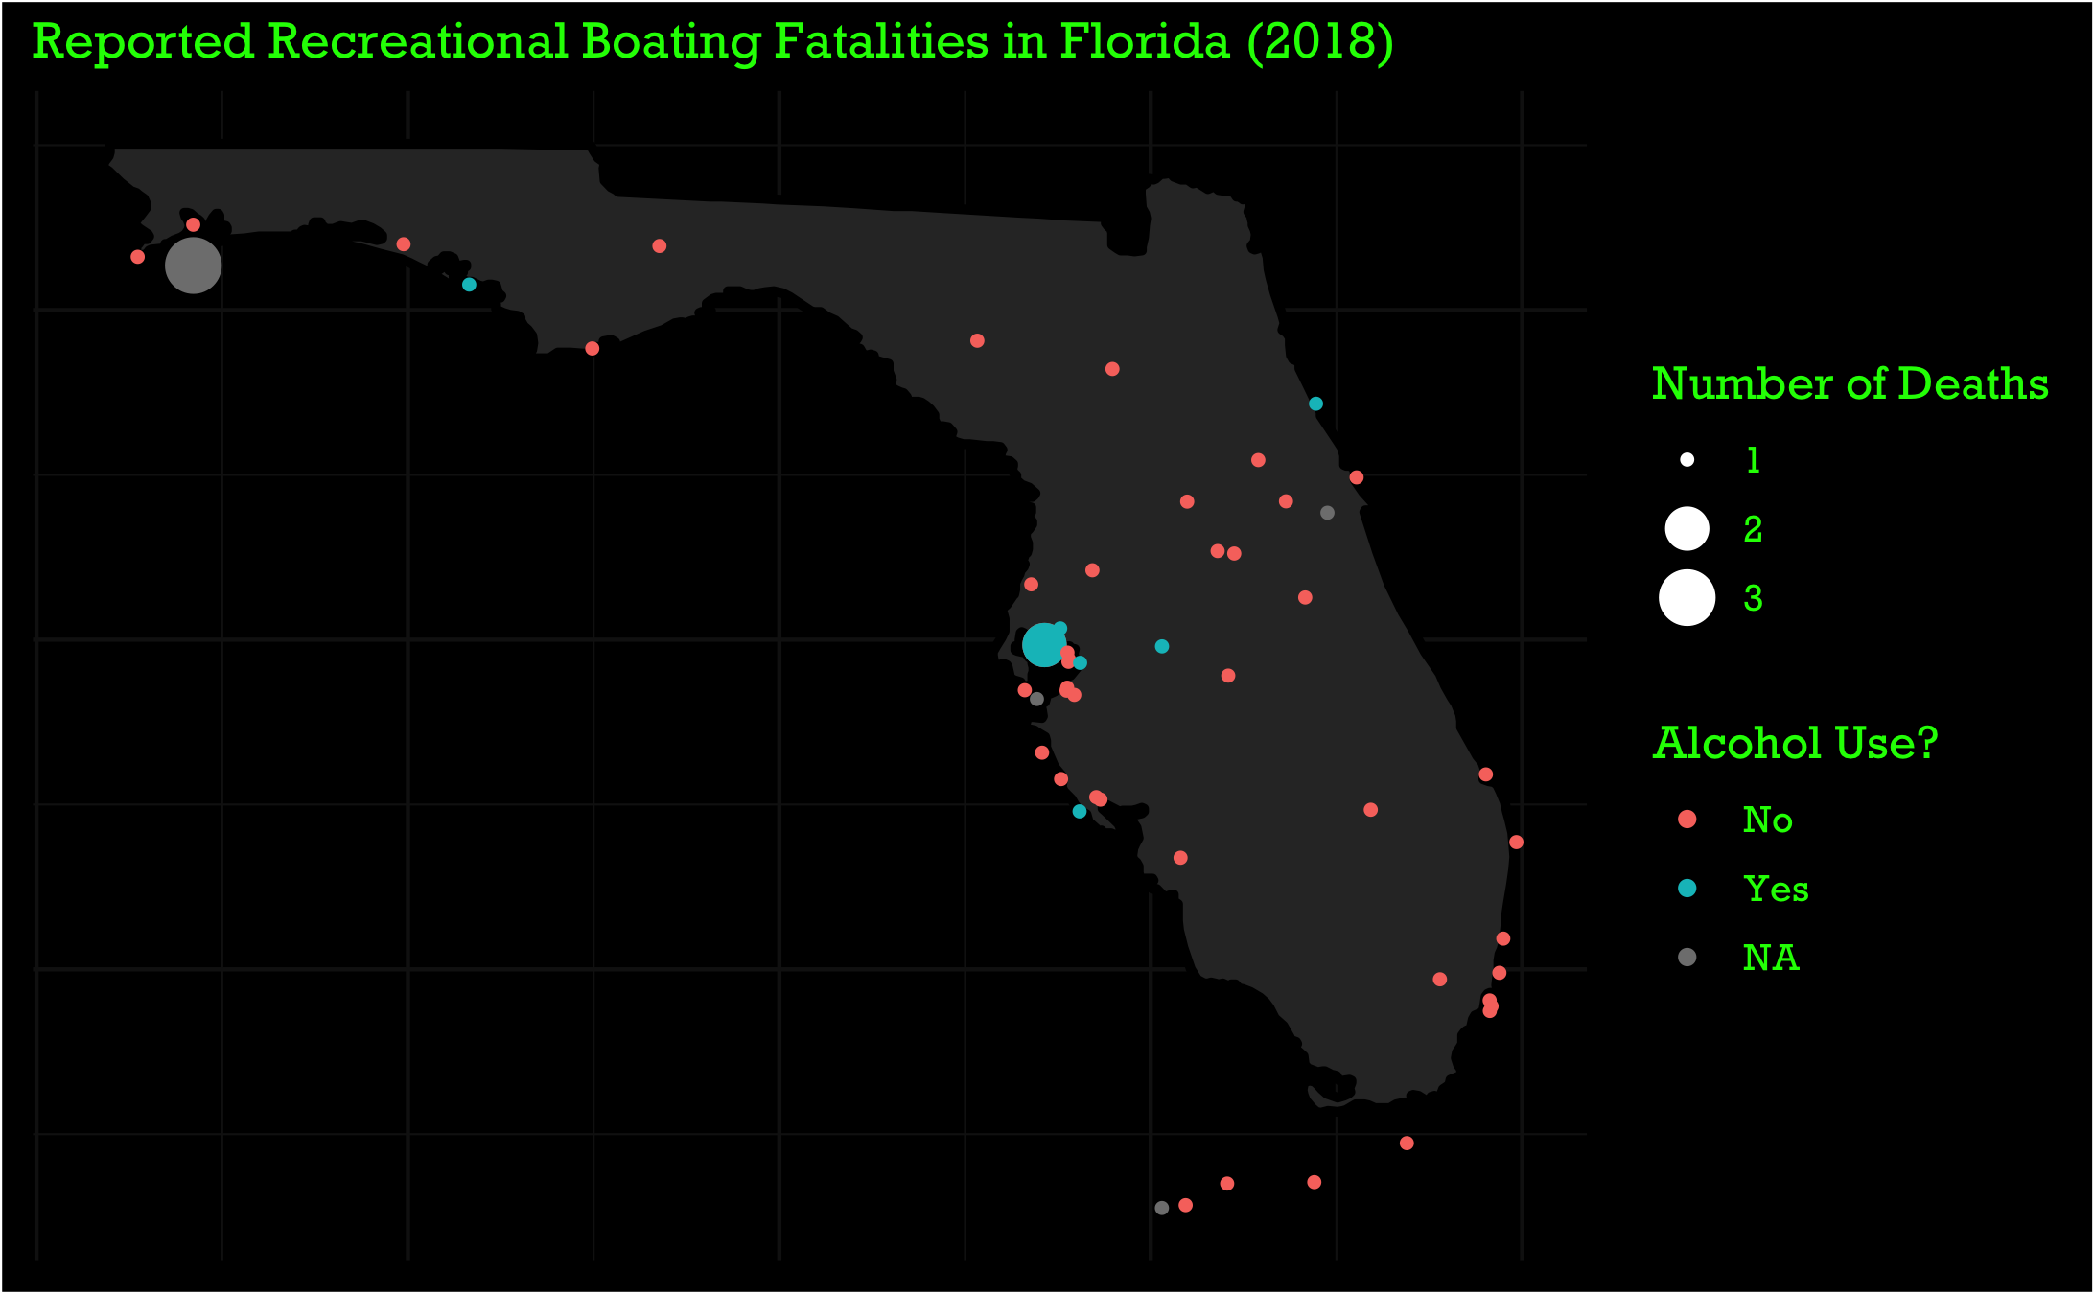

Slide 14
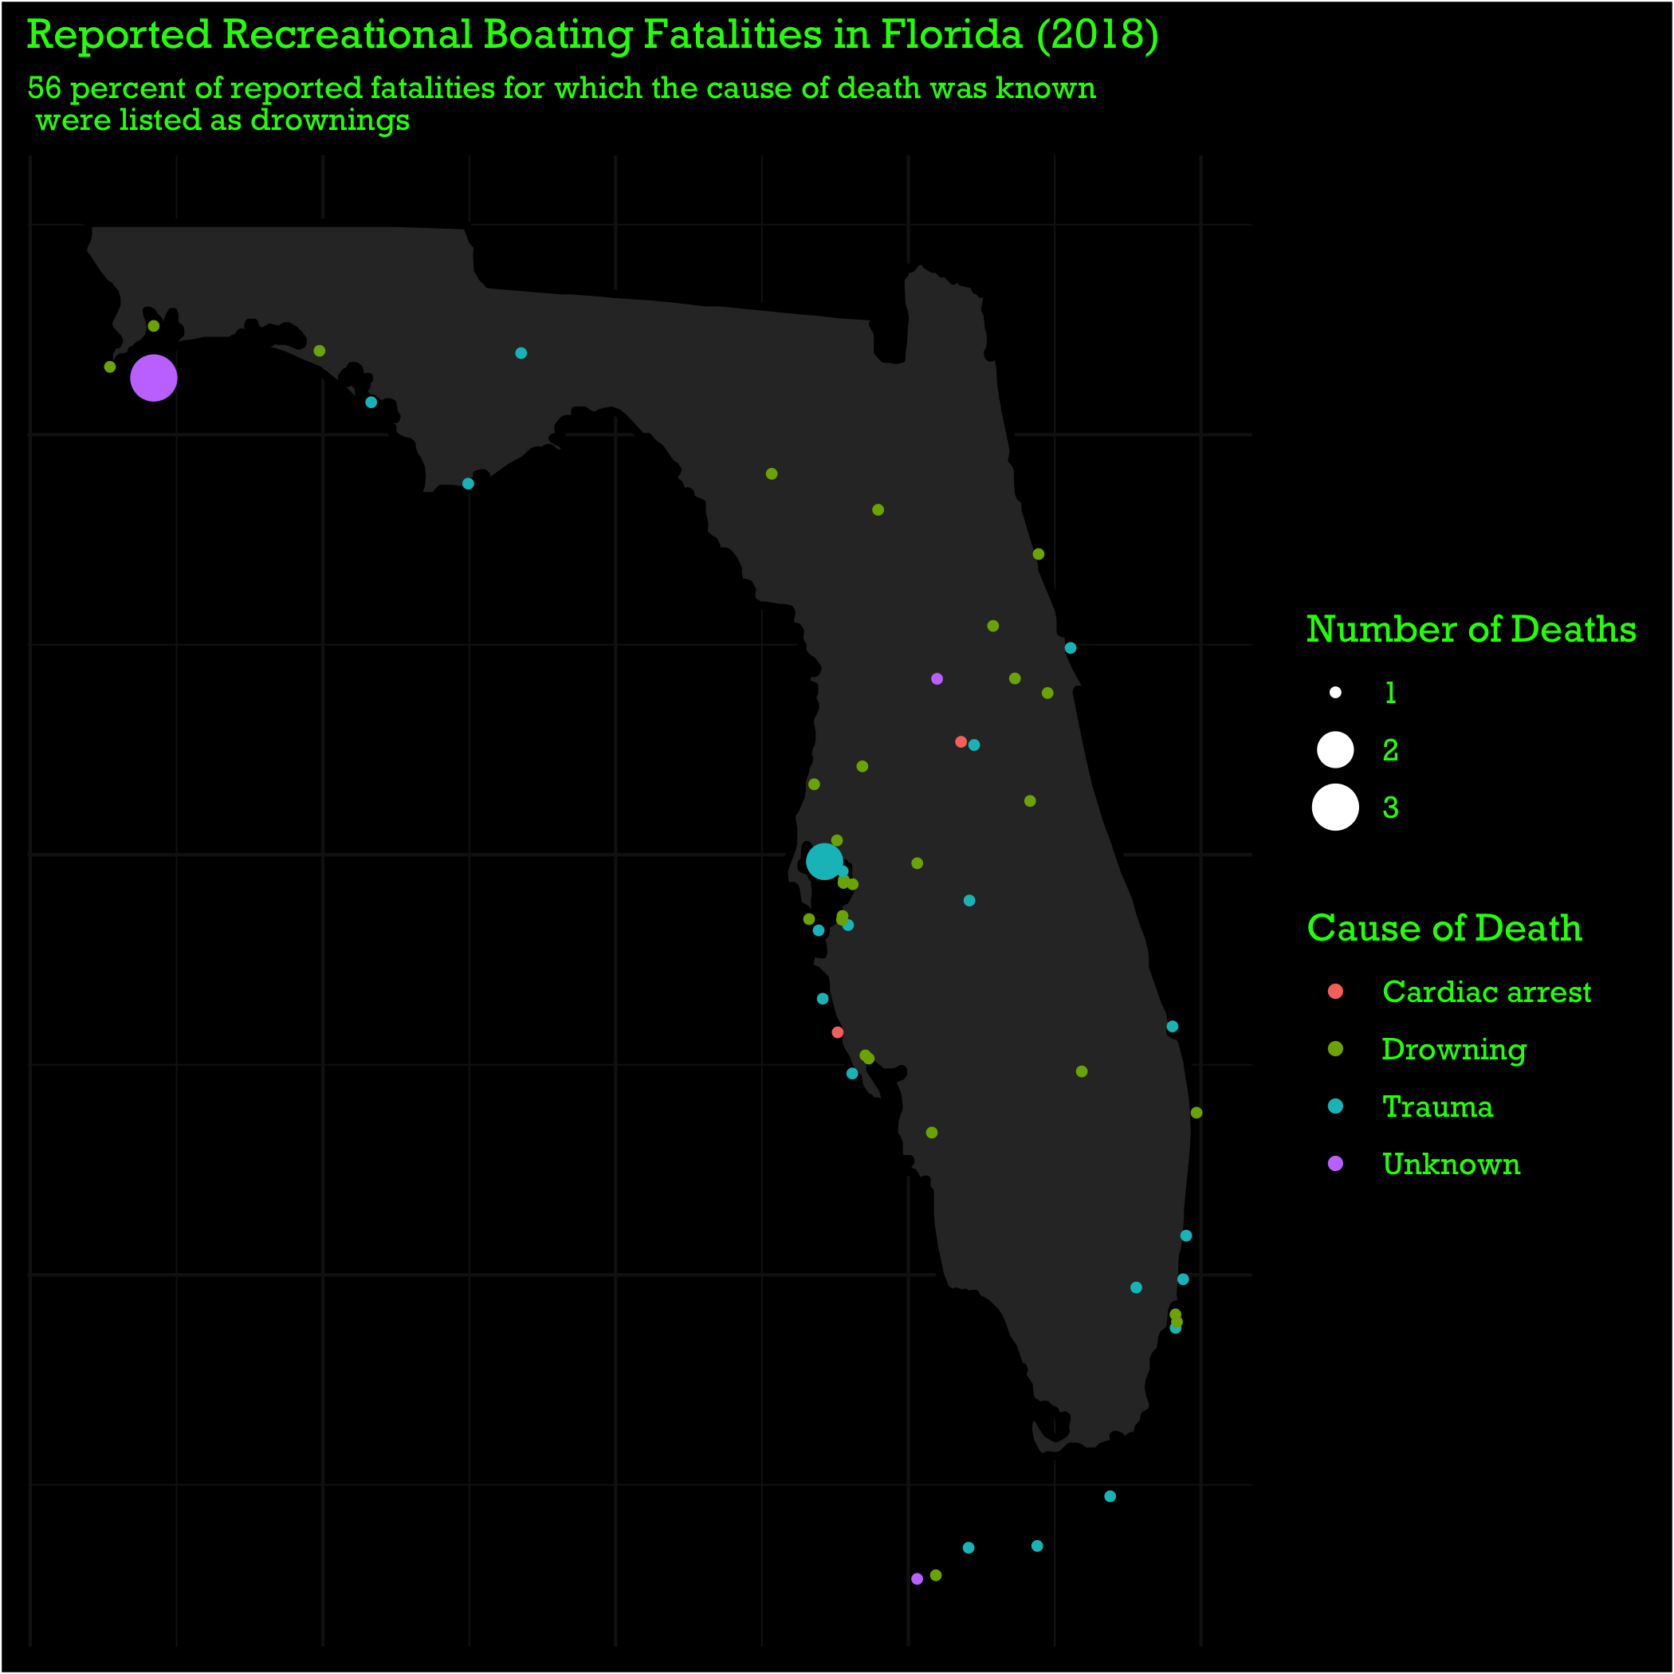

Slide 15
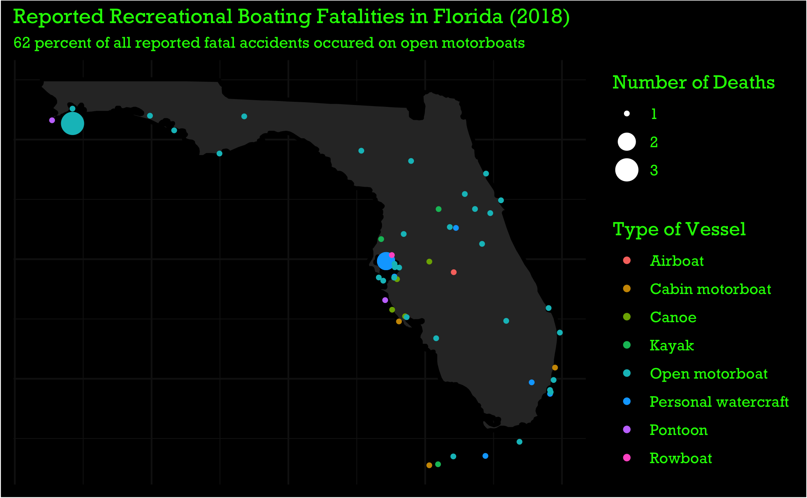

Slide 16
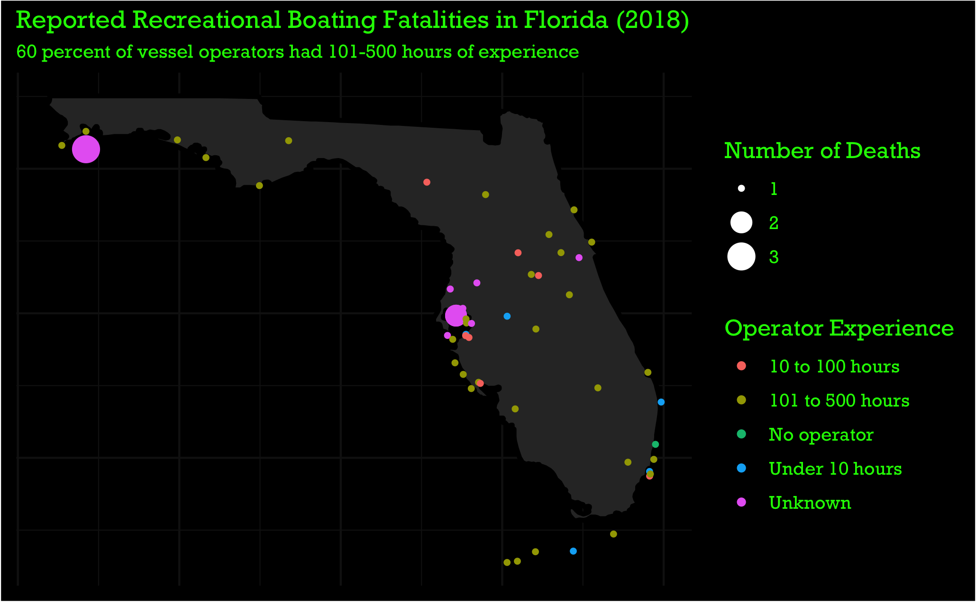

Slide 17
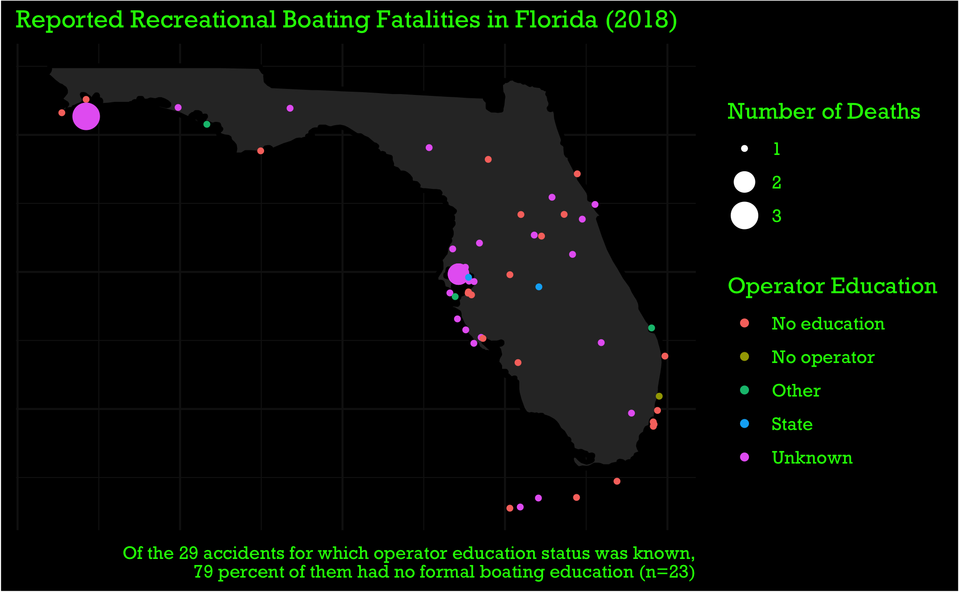
Notes:
Keep number of deaths as second label key

Slide 18
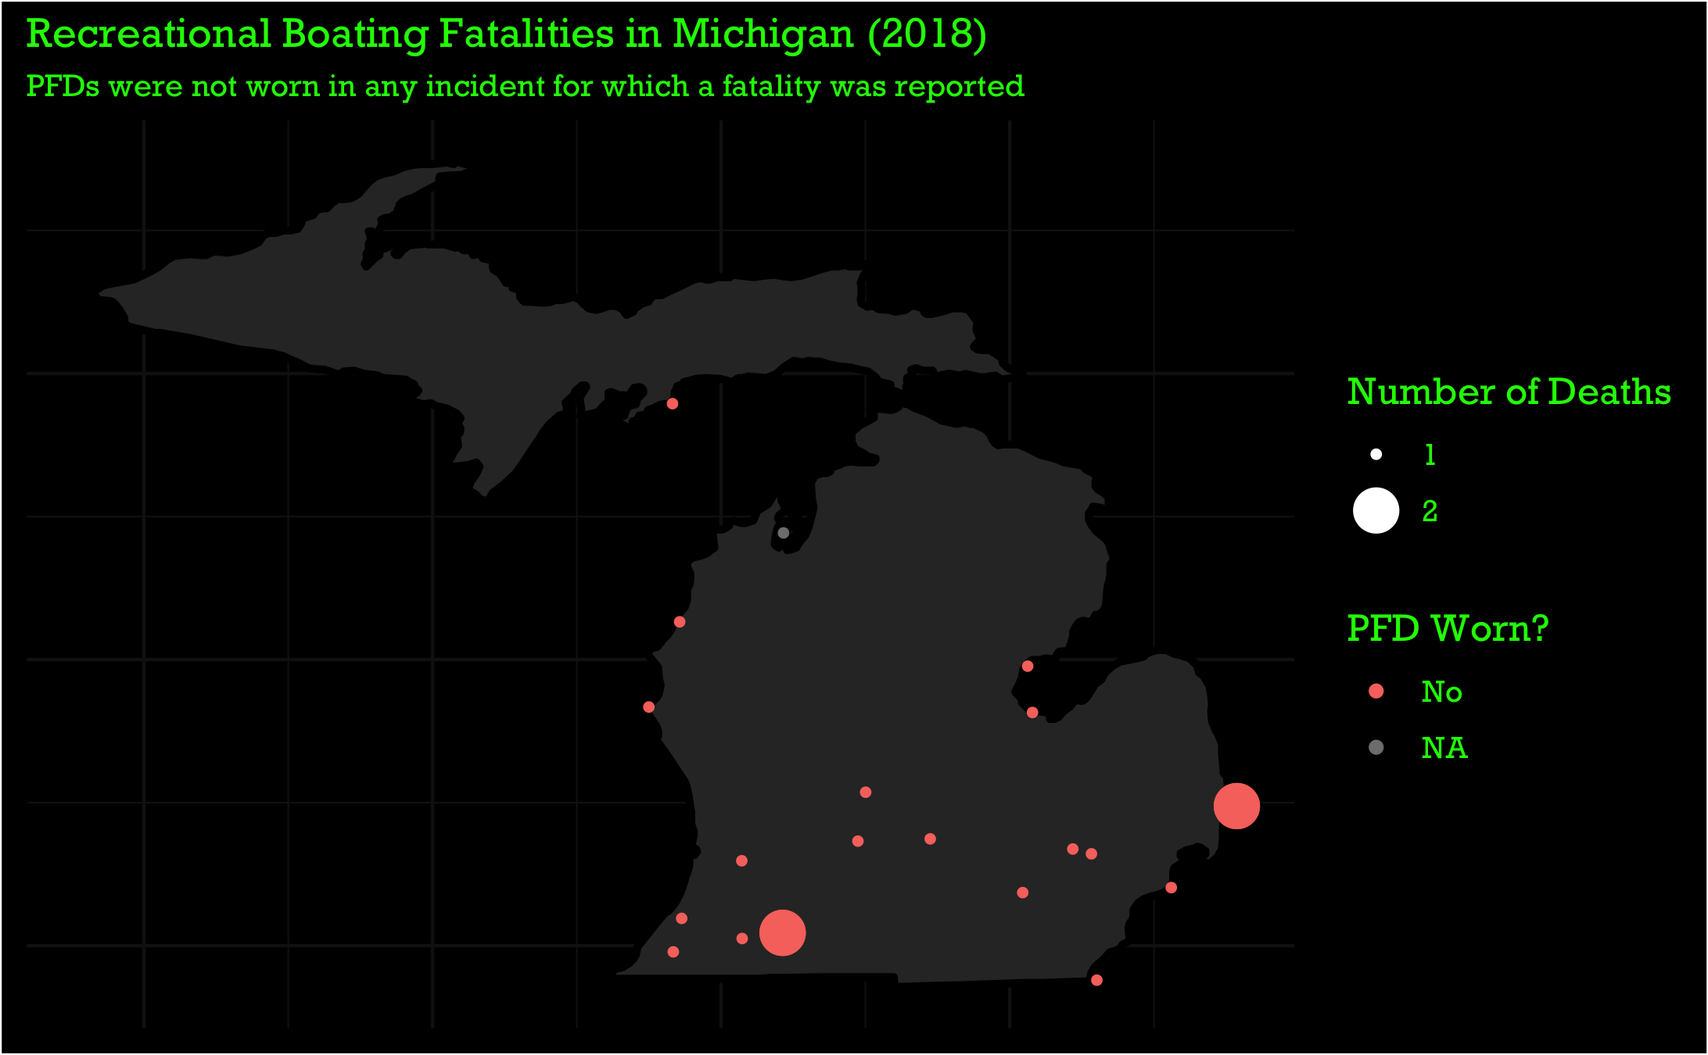

Slide 19
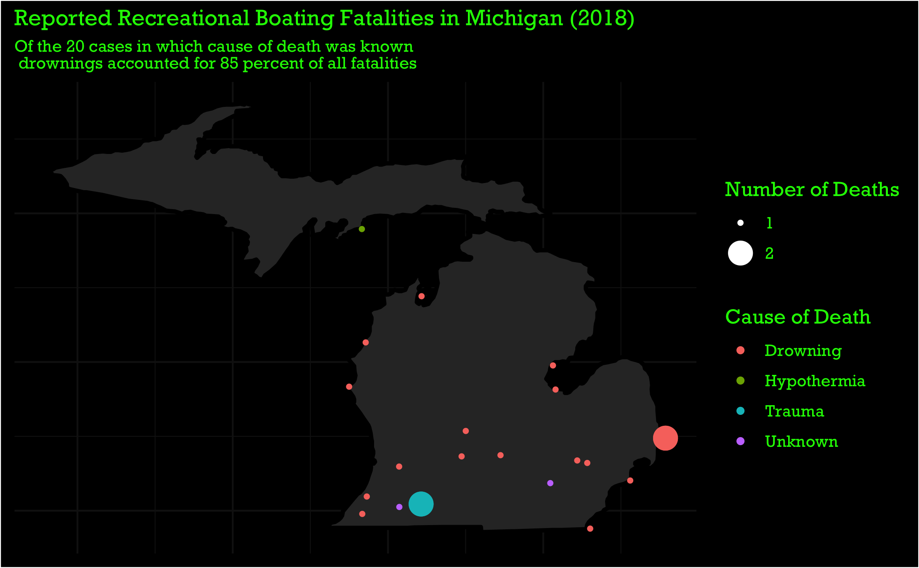

Slide 20
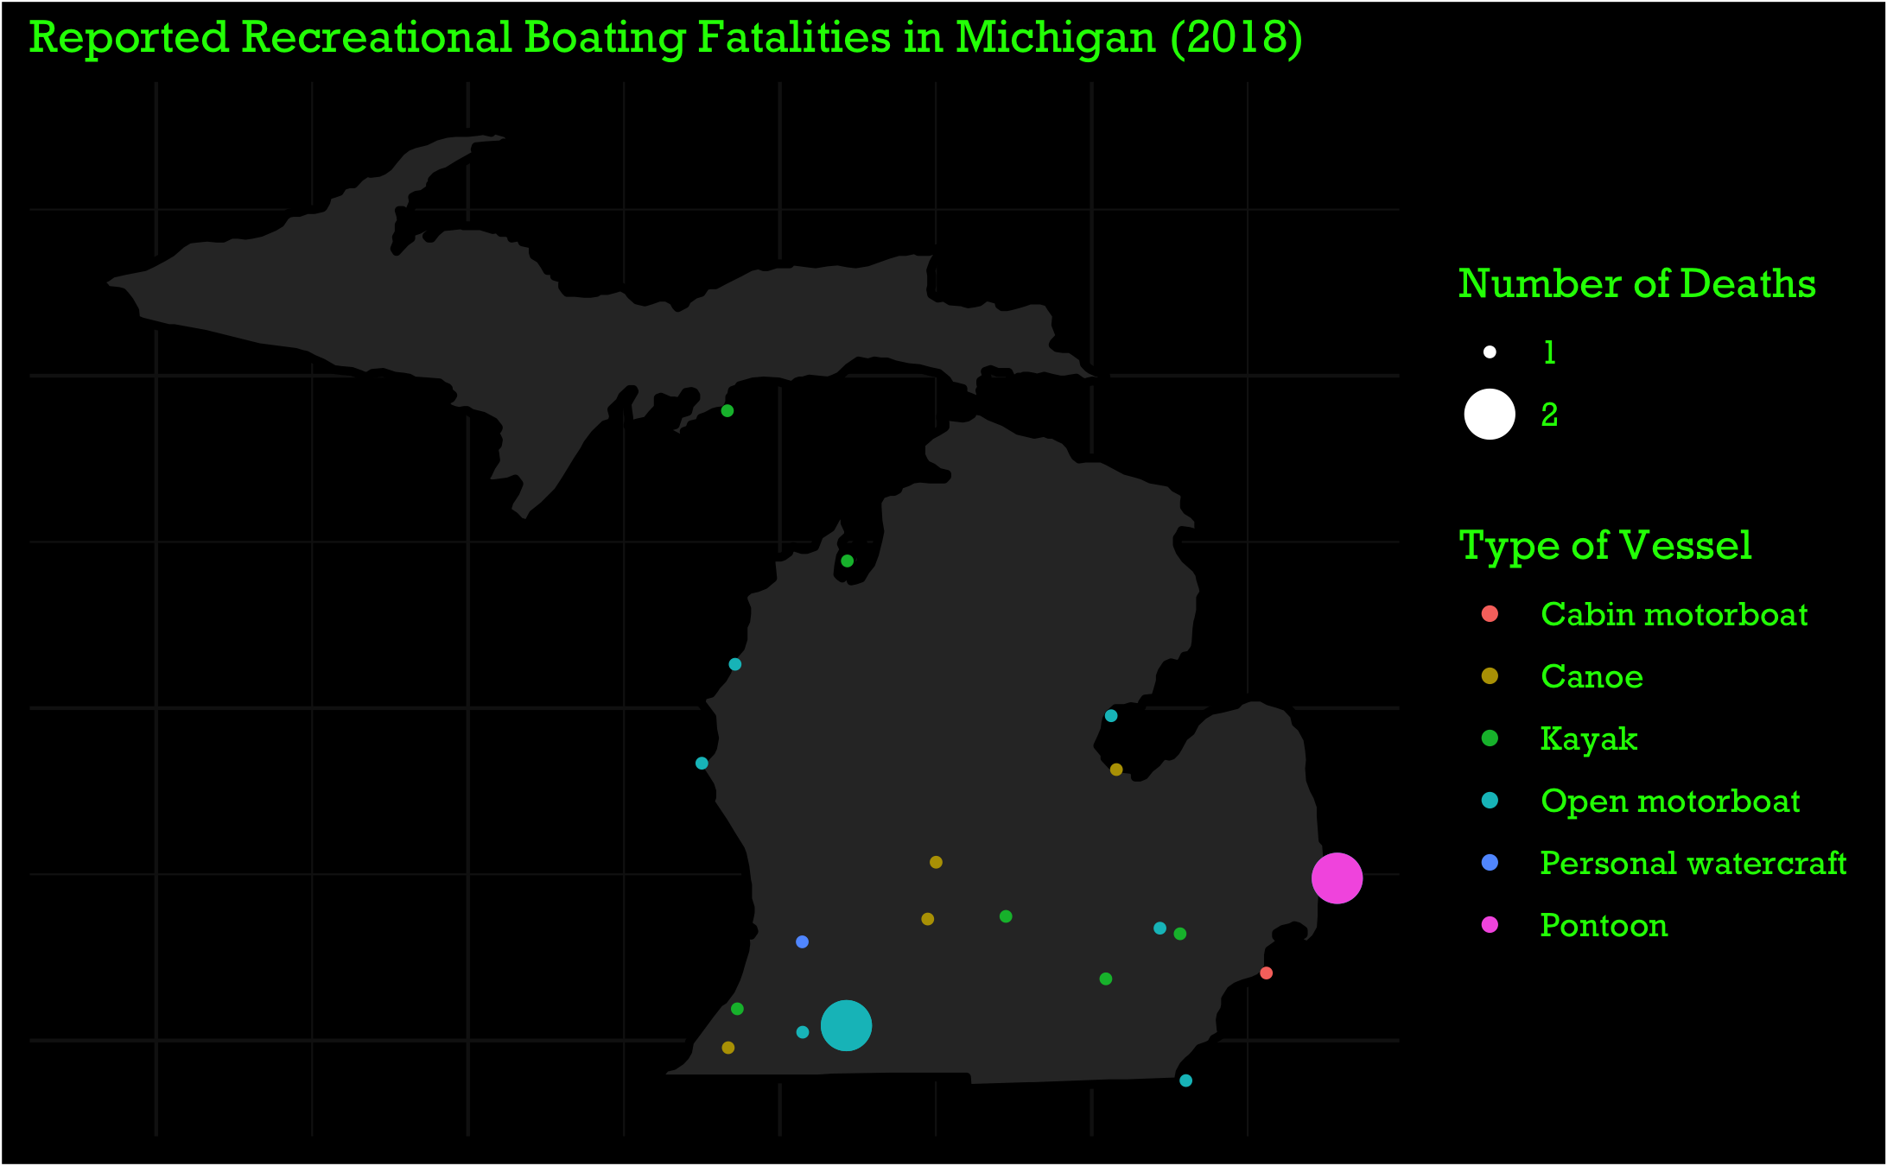

Slide 21
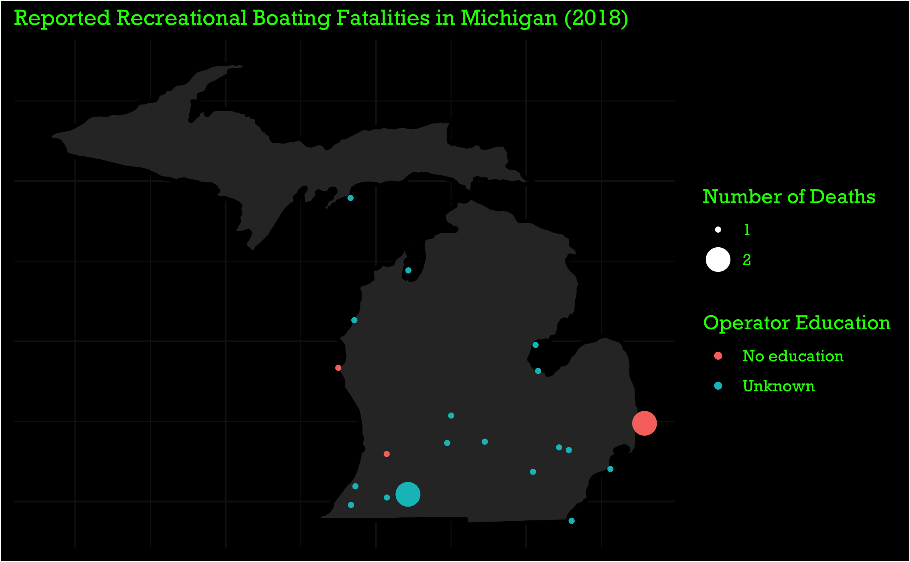
Notes:
The same thing applies for education…

Slide 22
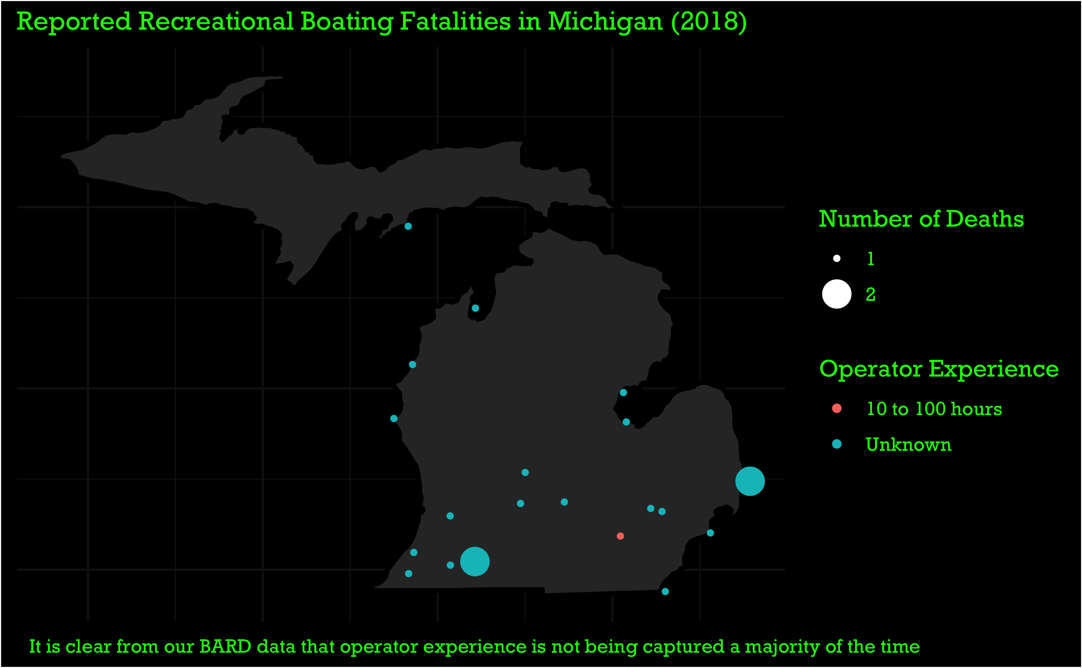
Notes:
This might be something we would want to share with the state of Michigan (or any other state in which this data is lacking).
Sometimes, awareness alone will encourage people to try harder. If they don’t realize they aren’t collecting something, why would they ever try?

Slide 23
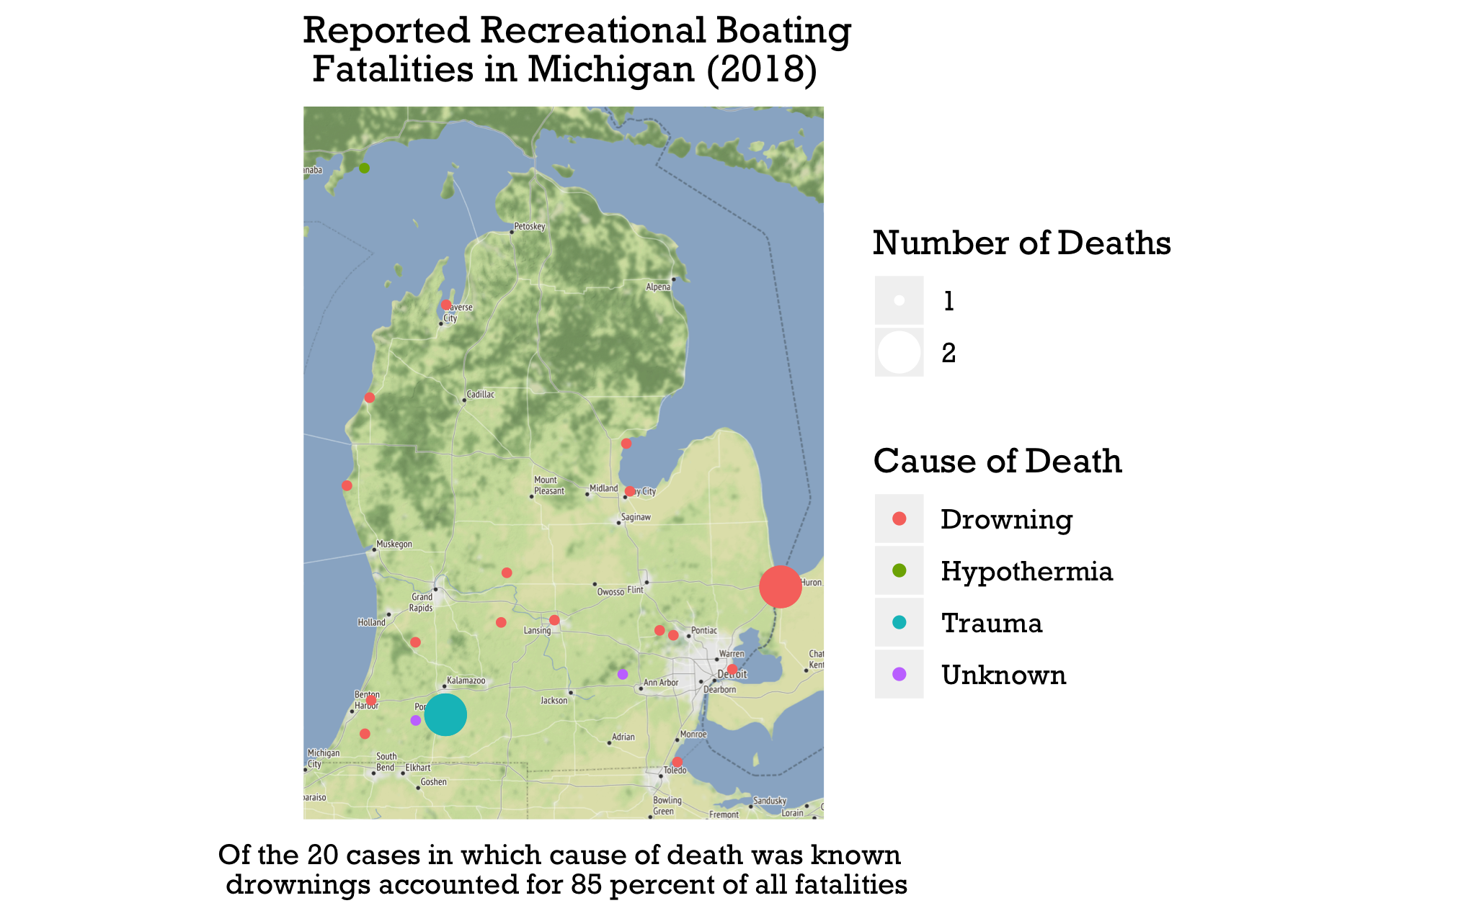

Slide 24
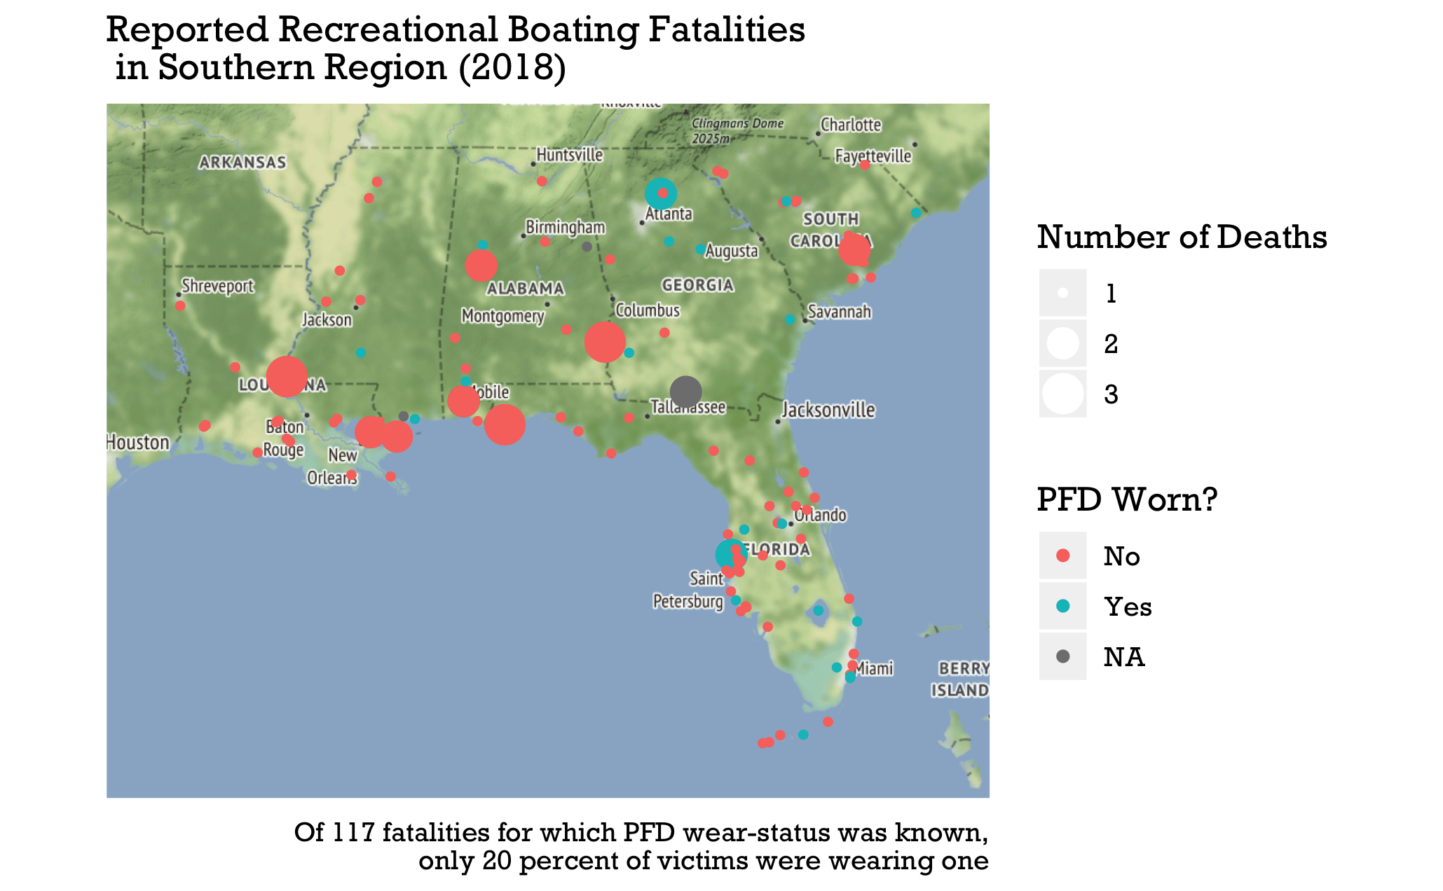

Slide 25
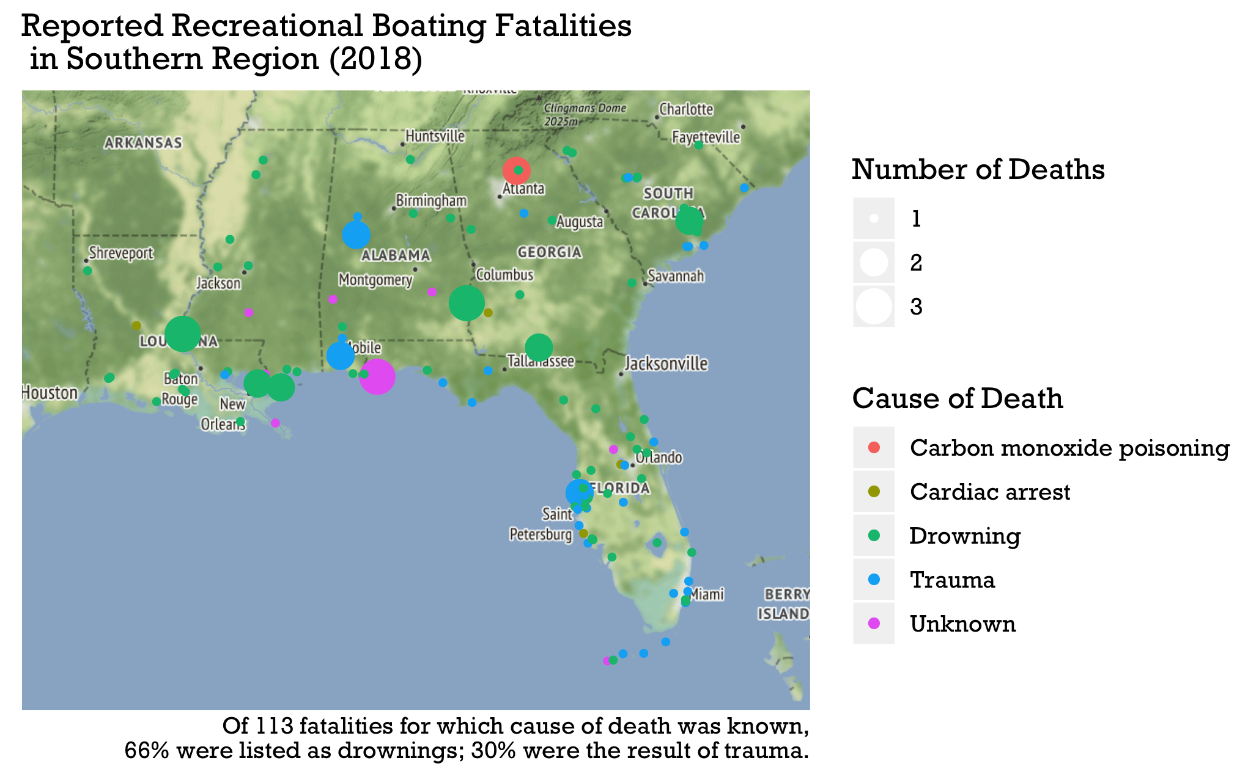

Slide 26
Questions? Comments? Concerns?

